Slide 1
CSS
MCNDHS
Ms. Eng

Slide 2
AIM: HOW DO WE CREATE DIV ELEMENTS ?
Do now:
Daily Grade:
On-time/attendance/not leaving the classroom: 25%
Cellphones: 25%
Notes:25%
Classwork/Homework: 25%

Slide 3
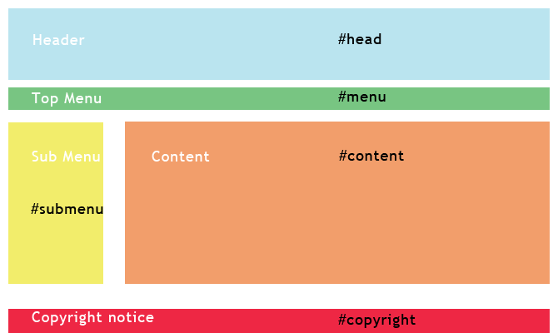
EXAMPLE 1:

Slide 4
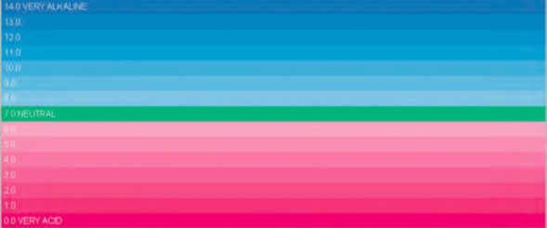
EXAMPLE 2:

Slide 5
MAIN HTML CODE AND CSS
<div id=“ “> </div>
# nameofid {
background-color: ;
height: ;
width: ;
}

Slide 6
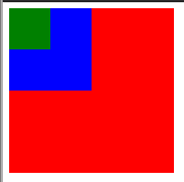

ACTIVTY:

